Slide 1

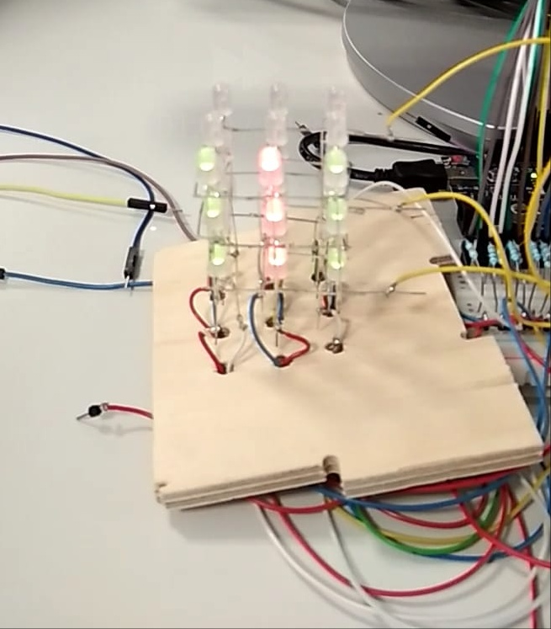
CUBE of bicolour LEDs
Course: Microprocessors Techniques and Embedded Systems (CMPT)
Docent: Tomáš Frýza
Project title: 3x3x3 bicolour LED cube
By: Jose Cuevas Mauricio Alexander J. Magnusson Amorós

Slide 2
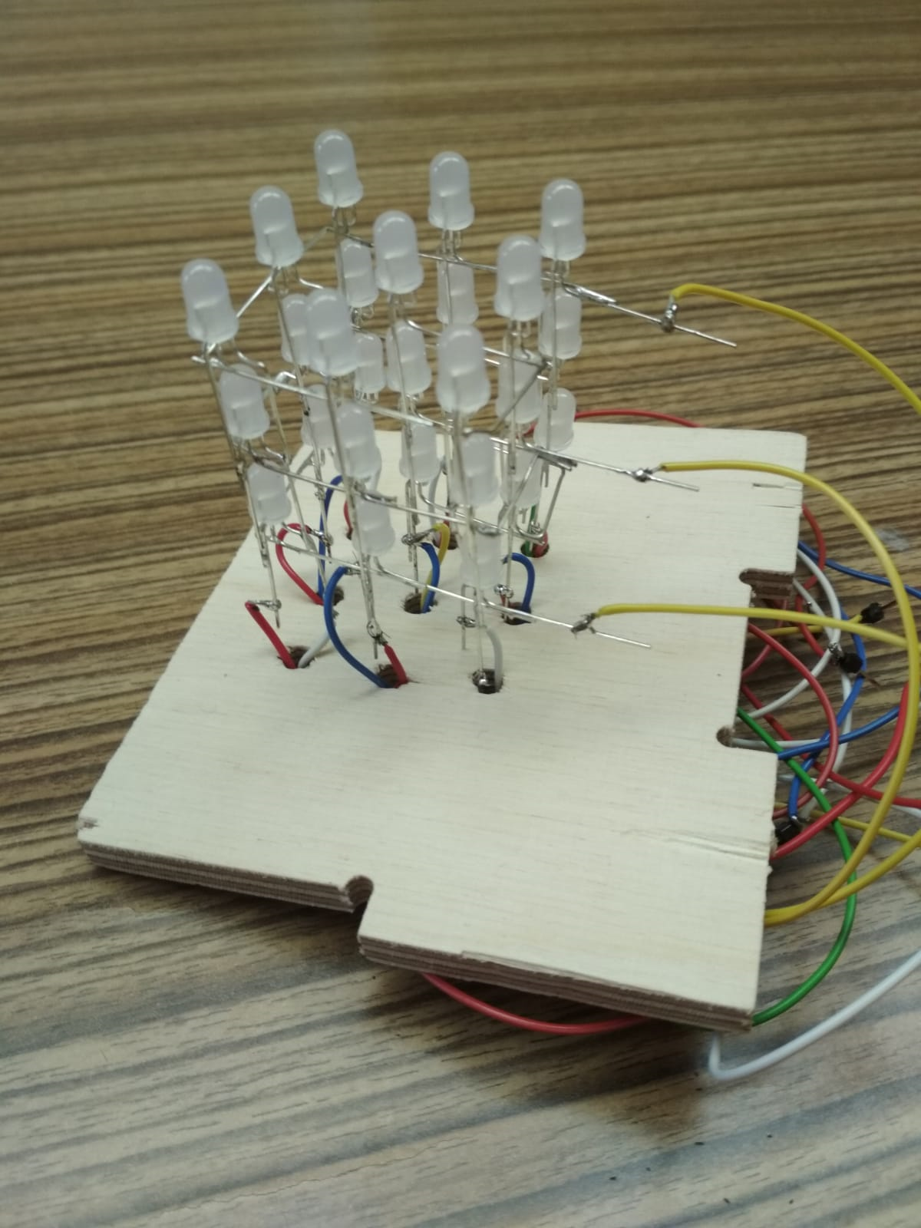
Presentation
The size of the cube is 3x3x3 LEDs
27 Multicolor LEDs (Red, Green and orange)
Course: Microprocessors Techniques and Embedded Systems (CMPT) Docent: Tomáš Frýza
Project title: 3x3x3 bicolour LED cube By: Jose Cuevas Mauricio & Alexander J. Magnusson Amorós

Slide 3
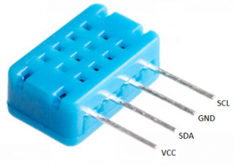
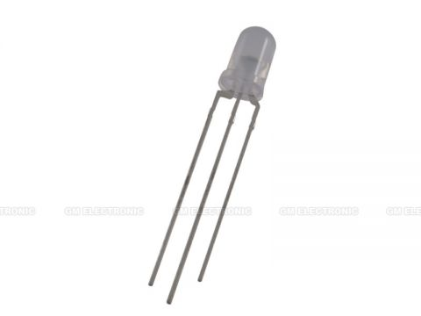
Features
-The LEDs have 2 anode and 1 cathode
- The animation is controlled by a temperature sensor
- 12 PIN for the LEDs and 2 for the temperature sensor in the arduino shield
Course: Microprocessors Techniques and Embedded Systems (CMPT) Docent: Tomáš Frýza
Project title: 3x3x3 bicolour LED cube By: Jose Cuevas Mauricio & Alexander J. Magnusson Amorós

Slide 4
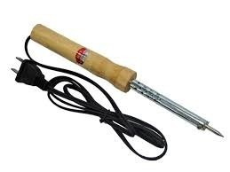
Assembly
-Soldering of the LEDs:
- The 3 anodes of every column are connected between them.
- The 9 cathodes of every row are connected between them.
- We use tin soldering
Course: Microprocessors Techniques and Embedded Systems (CMPT) Docent: Tomáš Frýza
Project title: 3x3x3 bicolour LED cube By: Jose Cuevas Mauricio & Alexander J. Magnusson Amorós

Slide 5
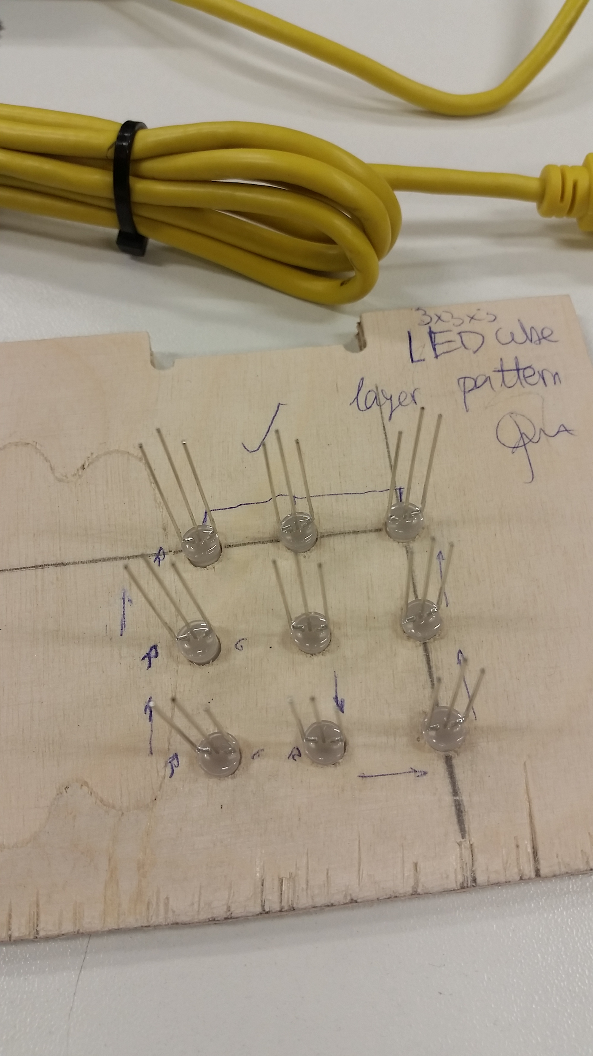
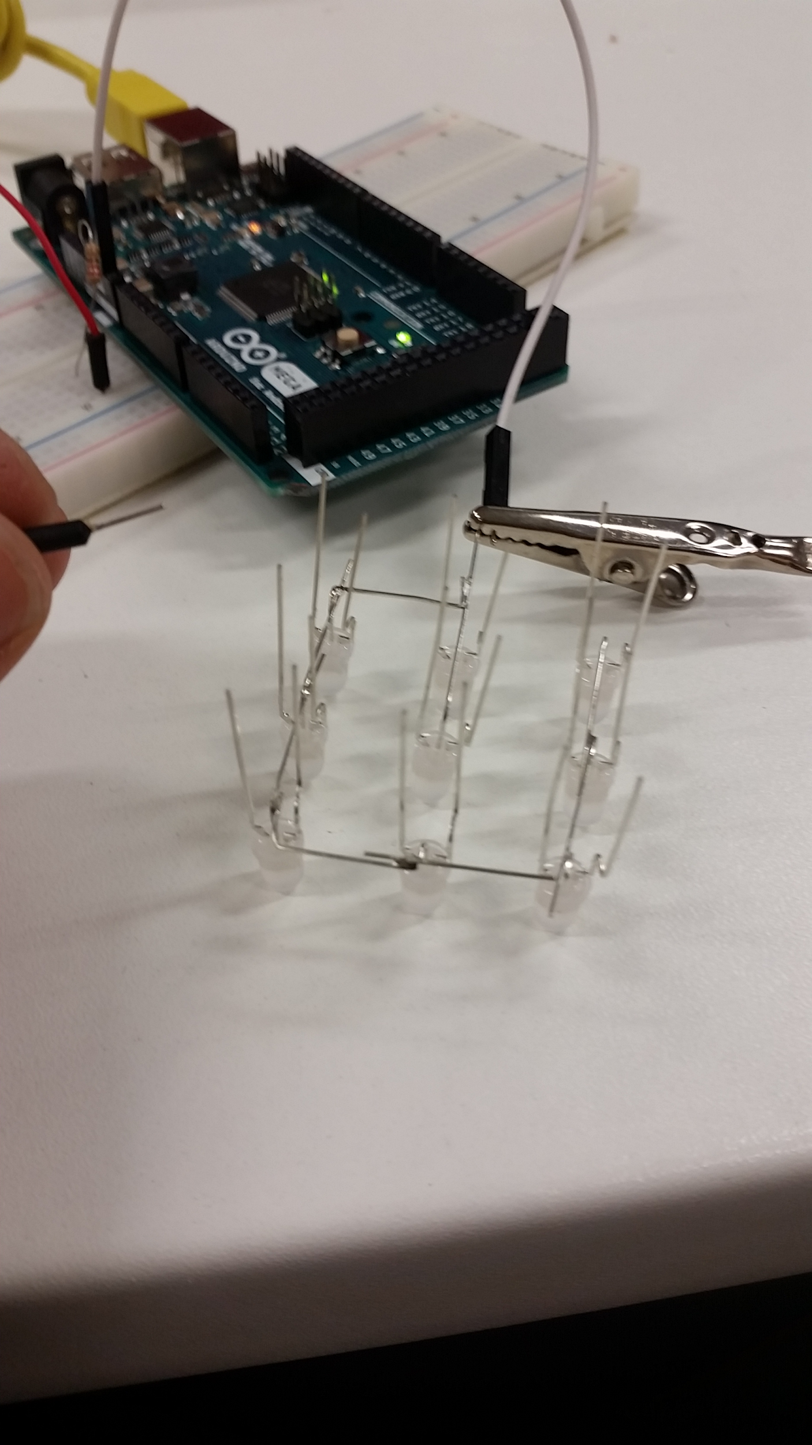
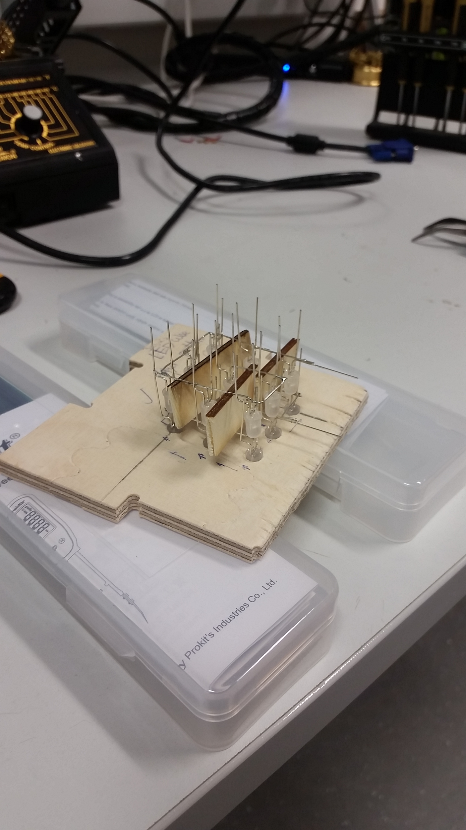
Photos Assembly
Course: Microprocessors Techniques and Embedded Systems (CMPT) Docent: Tomáš Frýza
Project title: 3x3x3 bicolour LED cube By: Jose Cuevas Mauricio & Alexander J. Magnusson Amorós

Slide 6
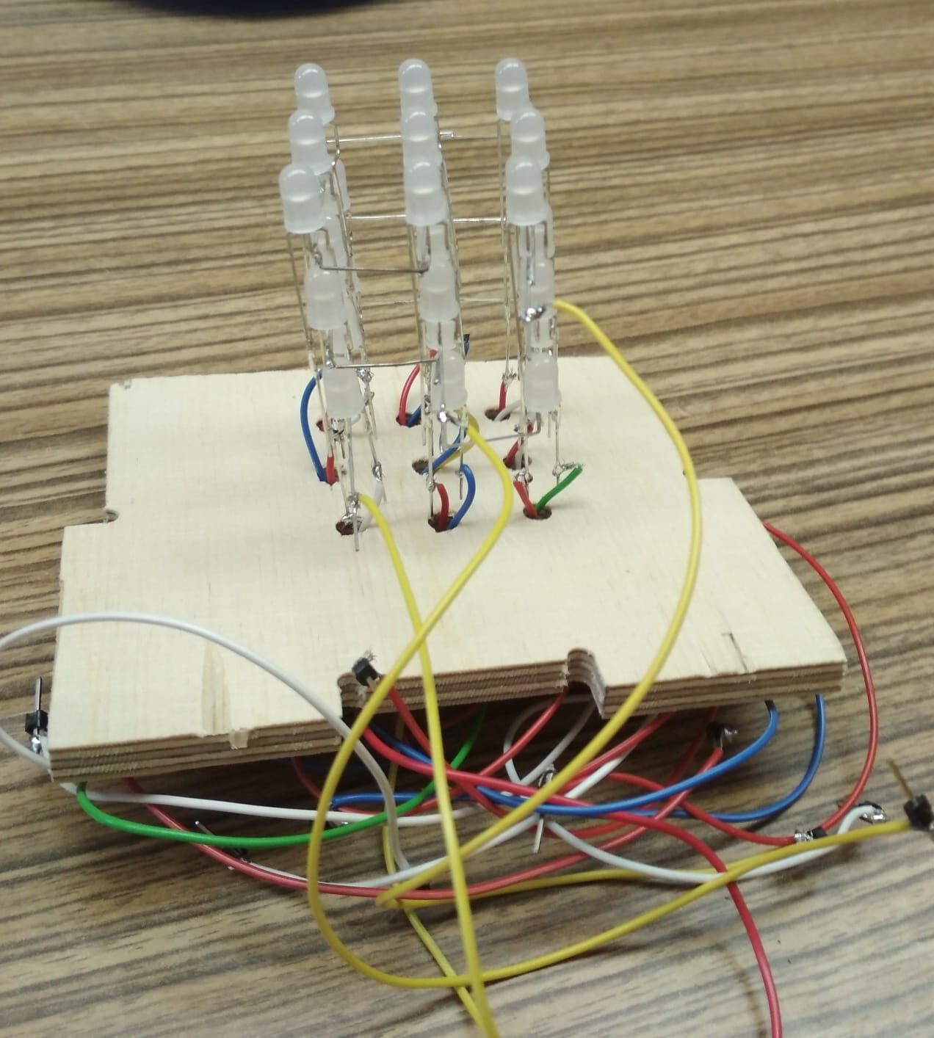
Example:
Course: Microprocessors Techniques and Embedded Systems (CMPT) Docent: Tomáš Frýza
Project title: 3x3x3 bicolour LED cube By: Jose Cuevas Mauricio & Alexander J. Magnusson Amorós

Slide 7
Code
Single anode testing
Full cube with Shift Registers
Course: Microprocessors Techniques and Embedded Systems (CMPT) Docent: Tomáš Frýza
Project title: 3x3x3 bicolour LED cube By: Jose Cuevas Mauricio & Alexander J. Magnusson Amorós
Notes:
AS for software we made a progressive approach, starting by connecting only one anode and later both. One anode means one color and 9 pins to be used to control them so no external chips needed. When using both anodes it doubles and SR are needed to reduce from 18 to 3 pins control (latch, clock and data)

Slide 8
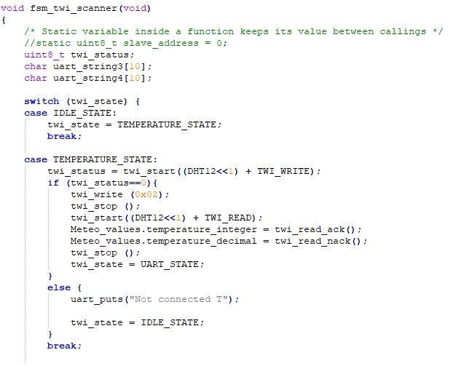
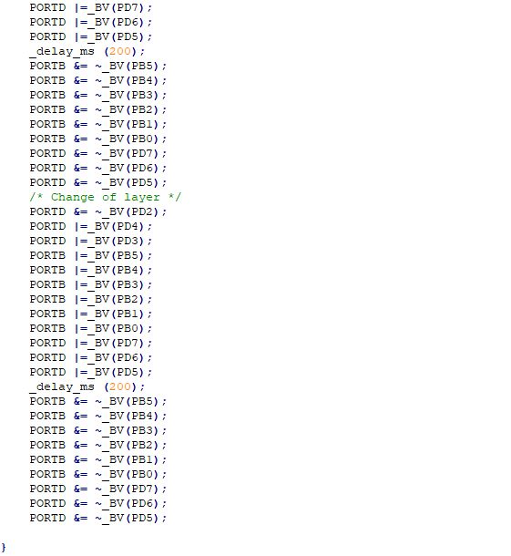
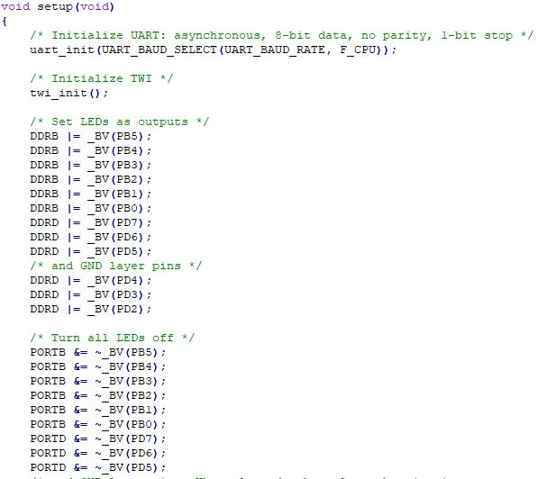
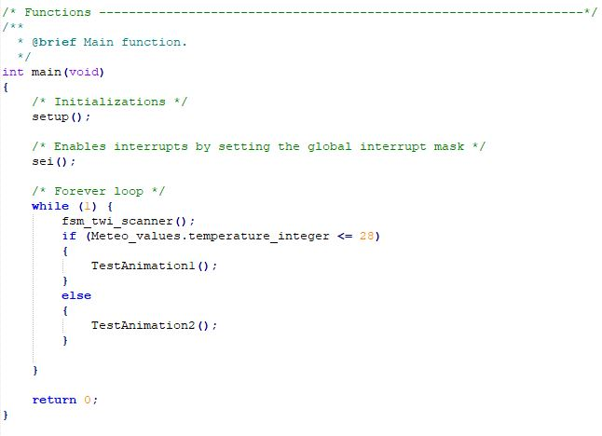
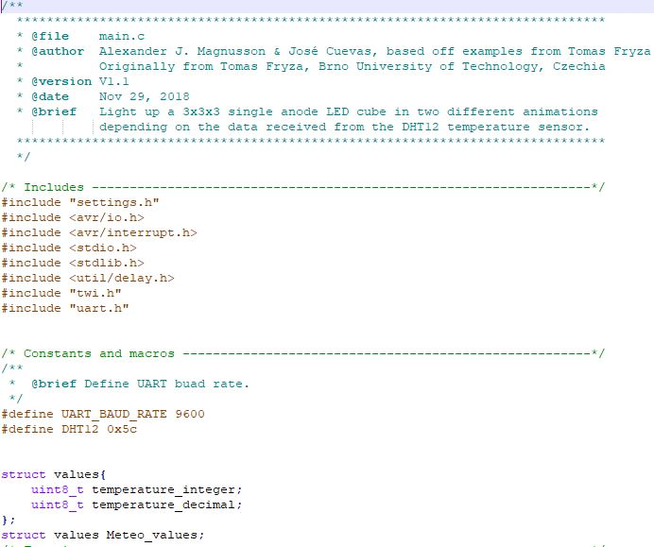
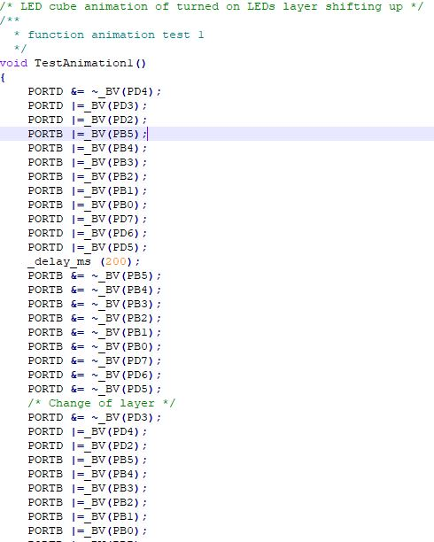
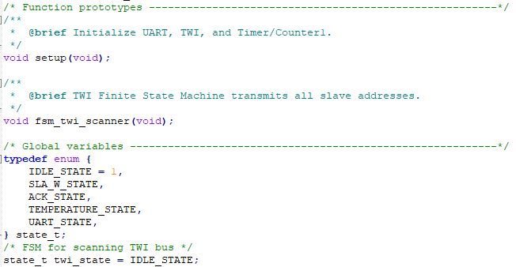
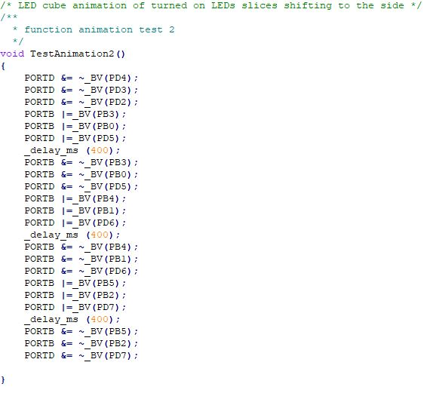
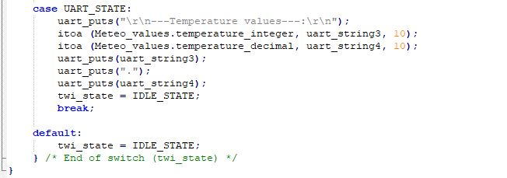
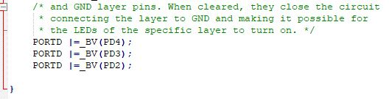
Code Single anode testing
Add more animations
Add more temperature ranges
Add more precise temperature conditions
Make animations for increasing or decreasing of temperature
Add humidity sensor
...
Course: Microprocessors Techniques and Embedded Systems (CMPT) Docent: Tomáš Frýza
Project title: 3x3x3 bicolour LED cube By: Jose Cuevas Mauricio & Alexander J. Magnusson Amorós
Notes:
The code is as follows, I will only show it briefly:
Header and macros
Global variables and function declaration
Main and functions: reading non-stop, then see whether the value corresponds to the cond and do one or the other. - Animation1 - Animation 2 - Sensor scanner

Slide 9
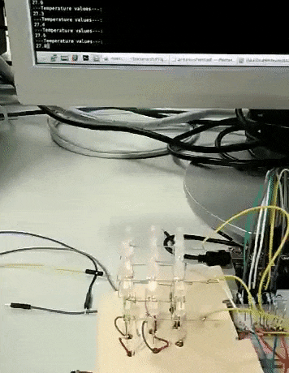
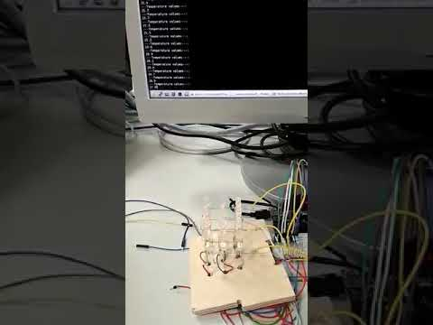

Results
https://github.com/Superpollo4/biLEDcube
Course: Microprocessors Techniques and Embedded Systems (CMPT) Docent: Tomáš Frýza
Project title: 3x3x3 bicolour LED cube By: Jose Cuevas Mauricio & Alexander J. Magnusson Amorós
Notes:
AS for software we made a progressive approach, starting by connecting only one anode and later both. One anode means one color and 9 pins to be used to control them so no external chips needed. When using both anodes it doubles and SR are needed to reduce from 18 to 3 pins control (latch, clock and data)

Slide 10
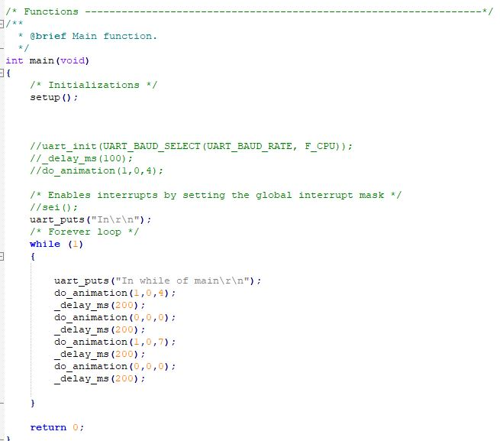

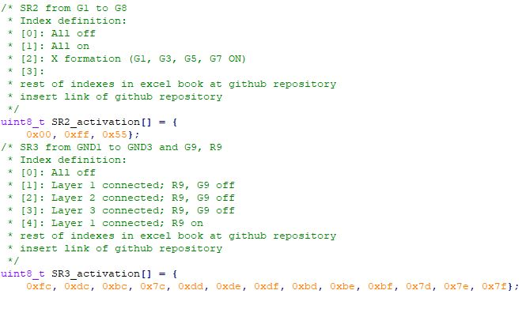
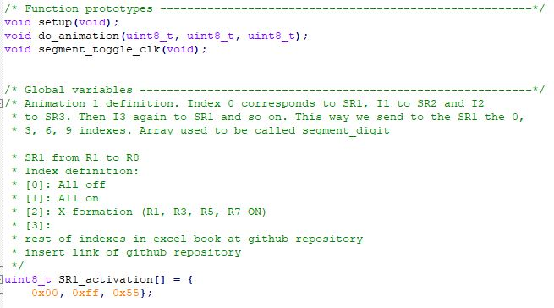
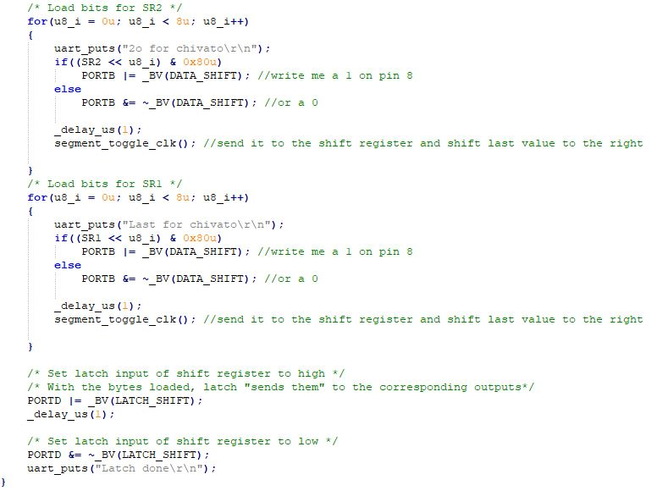
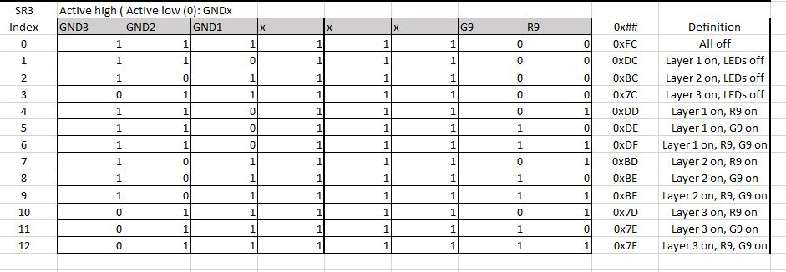
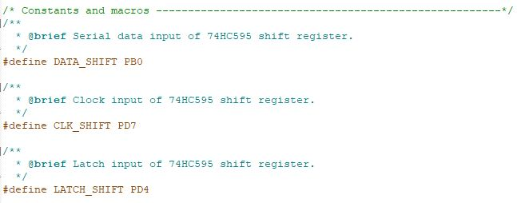
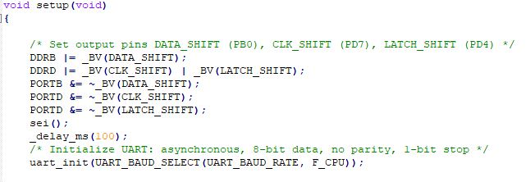
Code Full cube with Shift Registers
Course: Microprocessors Techniques and Embedded Systems (CMPT) Docent: Tomáš Frýza
Project title: 3x3x3 bicolour LED cube By: Jose Cuevas Mauricio & Alexander J. Magnusson Amorós
Notes:
Once we got the single anode working with sensor we continued, progressing the project to its full functinoality, true dual colour control of LEDs. To do this we used 3 8-bit SR that will take all the outputs from the cube (18 anodes + 3 gnd) and talk to them using only 3 pins of the microcontroler.
Again I will only show briefly the code, the changes:
new global variables for SR
addition of arrays to send the data: to make it more understandable I made an exccel sheet
main cycles through the do_animation function sending different values
do_animation function: asks for 3 int values that will corresponf to the index of the array for each SR. The value is then passed to the SR by clock function and later to the outputs by latch

Slide 11
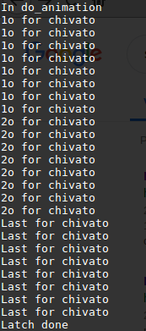
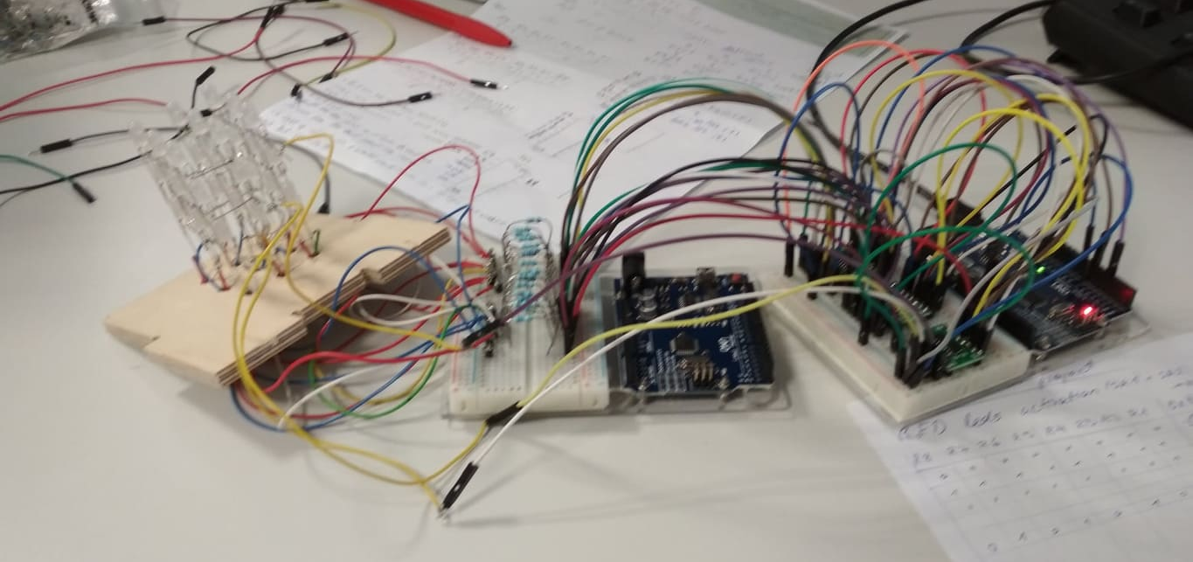

Results
Good communication and code delivery but no output
Not accomplished
https://github.com/Superpollo4/biLEDcube
Course: Microprocessors Techniques and Embedded Systems (CMPT) Docent: Tomáš Frýza
Project title: 3x3x3 bicolour LED cube By: Jose Cuevas Mauricio & Alexander J. Magnusson Amorós
Notes:
We managed to connect and send data but no output was activated.
Therefore the results from the second test where unsuccesful.

Slide 12
THANK YOU FOR YOUR ATTENTION
QUESTIONS
SUGGESTIONS
IMPROVEMENTS
ARE WELCOME =)
Course: Microprocessors Techniques and Embedded Systems (CMPT) Docent: Tomáš Frýza
Project title: 3x3x3 bicolour LED cube By: Jose Cuevas Mauricio & Alexander J. Magnusson Amorós
Notes:
AS for software we made a progressive approach, starting by connecting only one anode and later both. One anode means one color and 9 pins to be used to control them so no external chips needed. When using both anodes it doubles and SR are needed to reduce from 18 to 3 pins control (latch, clock and data)

